Slide 1
Stock Portfolio Dashboard
By Daulton Kendall and Justin Wong

Slide 2
Table of contents
1
5
2
6
3
7
4
Introduction
Use Cases
Data Architecture
Limitations
Dashboard view
Final Takeaways
Demo

Slide 3
Introduction
This project aims to create an intelligent portfolio analysis dashboard that empowers investors to monitor performance, classify risk, and generate exportable insights using real-time financial data and machine learning.
Key Objectives:
Provide real-time stock performance tracking and risk analytics.
Visualize diversification across region, sector, and asset metrics.
Classify portfolio risk using ML algorithms based on volatility, beta, and valuation.
Support exportable Excel/PDF reports for operational and reporting use.

Slide 4
Data Architecture
Data Flow Overview:
Input Layer: User-provided stock tickers and quantities entered via a dynamic form.
Ingestion Layer:
Data fetched from Yahoo Finance using the yfinance API.
Includes prices, dividend yield, beta, market cap, historical close, and more.
Processing Layer:
Cleansing & standardization of ticker and currency data.
Feature engineering (volatility, P/E, FX normalization).
Caching for performance using @st.cache_data.
Analytics Layer:
Risk classification using RandomForestClassifier.
Rolling volatility & normalized price performance.
Visual transformations for Plotly charts.

Slide 5
Data Governance
Real-Time Accuracy: yFinance API with defensive fallbacks and ticker validation.
Currency Normalization: FX-adjusted USD valuation via live currency conversion.
Caching & Performance: Efficient rendering via session caching and fail-safes.
Transparency: Visual and tabular outputs make all metrics verifiable.
Extensibility: Modular architecture supports ESG, NLP, or options analysis additions.

Slide 6
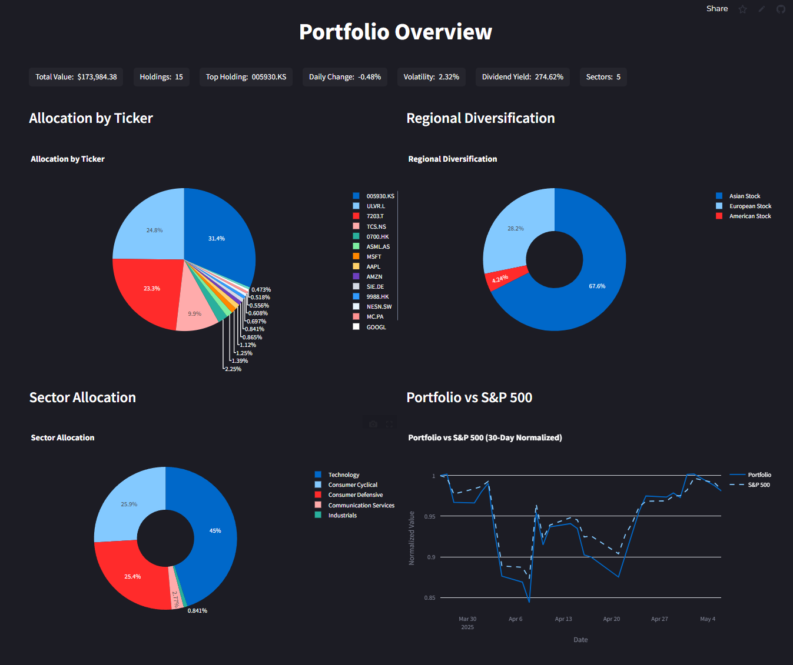
Core Dashboard
Overview: Allocation by ticker/sector/region, 30-day normalized value vs. S&P 500, top metrics.
Price Change & Volatility: Return periods (1D to 5Y), max drawdown, 52W high deviation, normalized price line.
Value Over Time: Benchmark overlays, logarithmic view toggle, FX-converted performance from 2020+, max drawdown and returns table.
Risk Classification: Predictive labeling (Low/Moderate/High), risk-adjusted recommendations, Volatility vs. Beta bubble chart.
Summary: Bollinger Bands, RSI, SMA crossovers, radar chart (P/E, Beta, Yield).
Export: Full PDF/Excel download with technical and fundamental indicators.

Slide 7
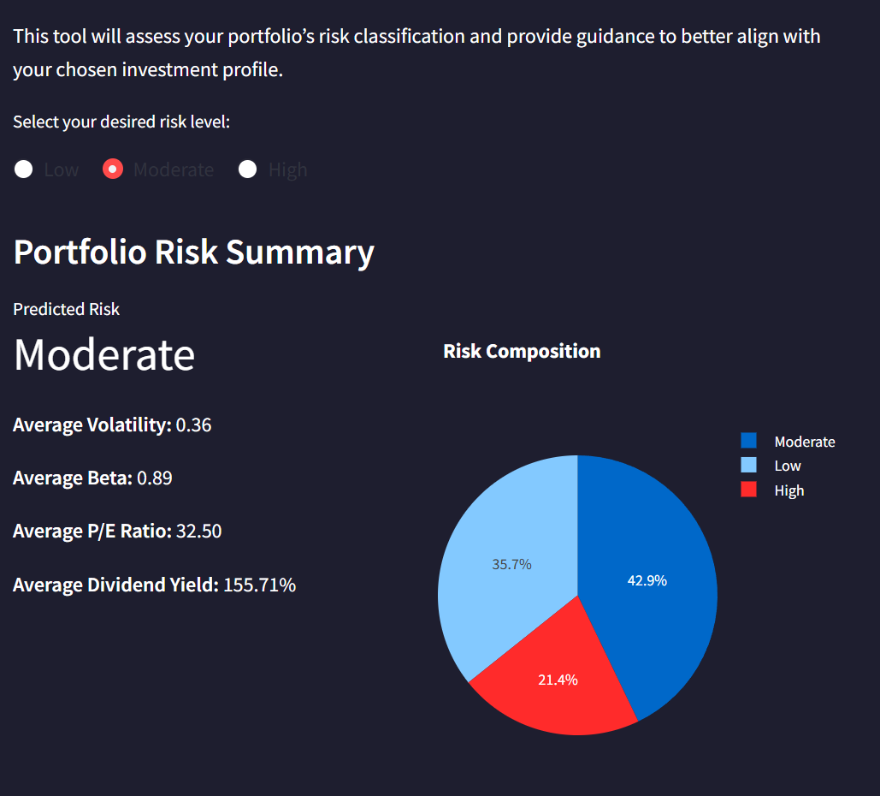
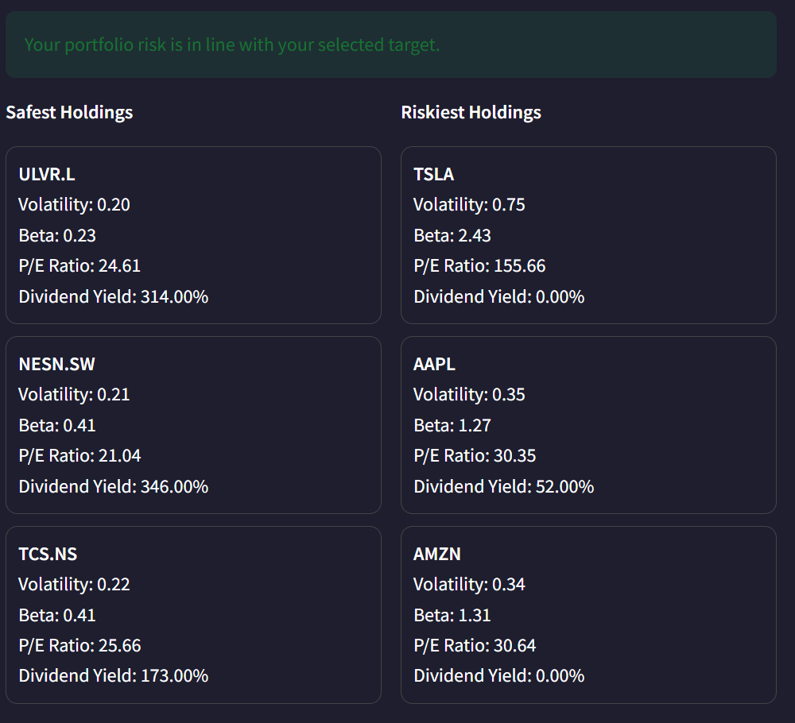
Portfolio Risk Classifier
Uses RandomForestClassifier to assign each stock a risk label (Low, Moderate, High) based on volatility, beta, P/E ratio, dividend yield, and price deviation.
Compares predicted portfolio risk to user-selected risk tolerance to generate alignment recommendations.
Visuals:
Risk Composition Pie
Volatility vs Beta Scatter
Model is designed for transparency and can be expanded with advanced explainability methods like SHAP or LIME
Offers a machine learning-based risk view that adapts to real-time financial shifts and evolving market behavior.
Enables users to identify risk concentration and consider rebalancing actions to better align with their objectives.

Slide 8
Stock Trading Dashboard
Select a stock from the portfolio to access a full trading view driven by technical and fundamental data.
Key metrics include current price, earnings per share (EPS), beta, dividend yield, relative strength index (RSI), volume trends, and upcoming earnings dates.
Provides multiple perspectives for assessing momentum, valuation, and trading signals.
Integrates live data visualizations and calculated indicators to support informed, data-backed decision-making.
Visual Modules:
Price Trend & Technical Signals:
Line chart with Bollinger Bands, SMA 50, and SMA 200 overlays.
Trend reversal indicators embedded within band positioning.
Momentum & Volume:
RSI chart with 70/30 thresholds highlights potential overbought/oversold conditions.
20-day rolling volume trends provide liquidity insights.

Slide 9
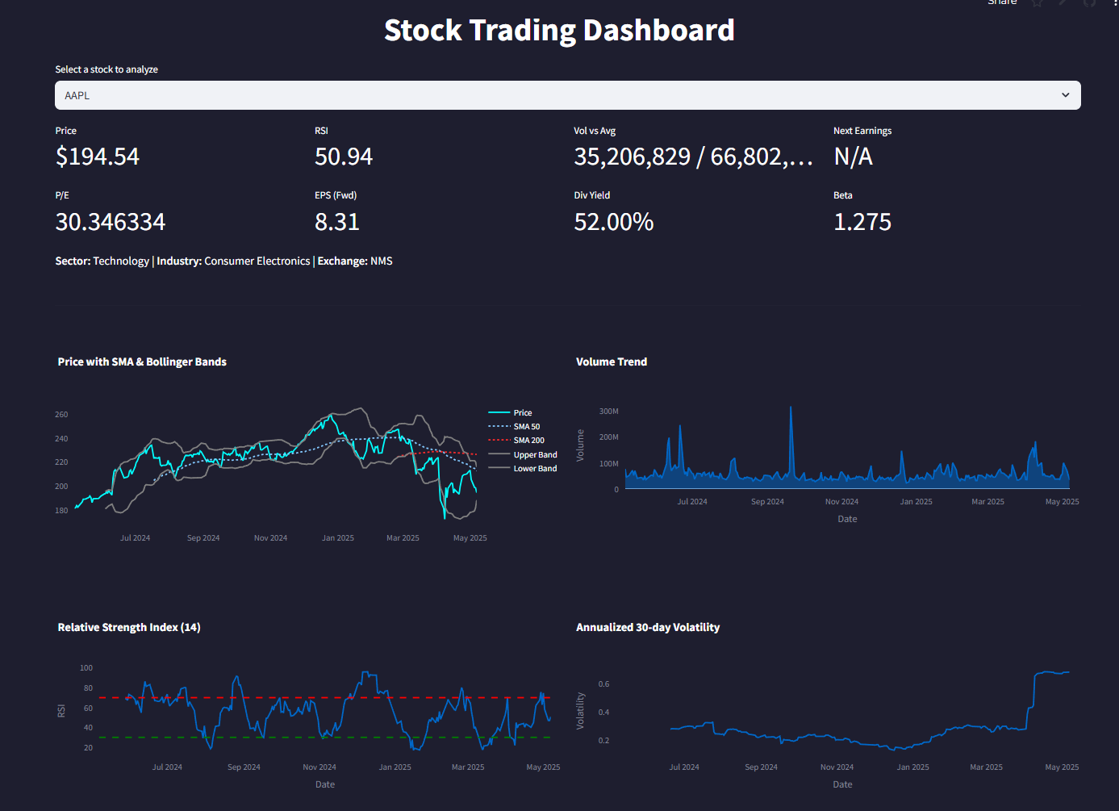
Stock Trading Dashboard
Select a stock from the portfolio to access a full trading view driven by technical and fundamental data.
Key metrics include current price, earnings per share (EPS), beta, dividend yield, relative strength index (RSI), volume trends, and upcoming earnings dates.
Provides multiple perspectives for assessing momentum, valuation, and trading signals.
Integrates live data visualizations and calculated indicators to support informed, data-backed decision-making.
Visual Modules:
Price Trend & Technical Signals:
Line chart with Bollinger Bands, SMA 50, and SMA 200 overlays.
Trend reversal indicators embedded within band positioning.
Momentum & Volume:
RSI chart with 70/30 thresholds highlights potential overbought/oversold conditions.
20-day rolling volume trends provide liquidity insights.

Slide 10
DEMO SLIDE
Portfolio management tool link

Slide 11
Use Cases
Retail Investors
Portfolio Managers
Financial Analysts
Gain personalized insights into diversification, risk exposure, and growth trends. Easily visualize portfolio allocations and identify actionable areas for rebalancing.
Assess sector and regional exposure at scale with integrated metrics and risk classifiers. Export reports for investment committees and strategy updates.
Use historical price, volatility, and valuation trends to build research narratives. Access deep technical charts and rolling performance benchmarks for modeling.

Slide 12
Limitations
Data Source
Input Method
Currently relies on Yahoo Finance, which offers free but throttled data with occasional delays or missing fields. A future version could integrate premium APIs like Bloomberg or Polygon for higher reliability and institutional-grade coverage.
Users input tickers manually, limiting scale and integration. Enabling CSV import, brokerage API sync, or OAuth login would streamline data entry and allow real-time updates.
ML Model
Asset Classes
Uses a single Random Forest Classifier for risk prediction. Future expansion could include ensemble models or regression for expected return forecasting, enhancing predictive power.
Focused solely on equities. Expanding to ETFs, fixed income, or crypto would support a broader investor base and enhance portfolio diversification analysis.

Slide 13
Ethical, Legal, Societal Implications
Transparency: Model decisions (e.g. risk classification) are explainable and based on well-defined financial metrics.
Data Limitations: Yahoo Finance is a free and public data source with throttling and gaps; results may vary depending on data completeness.
Model Caution: Outputs are based on historical metrics and machine learning predictions. These should inform—not replace—human judgment.
No Financial Advice: This tool is intended for educational and informational purposes only. It does not provide personalized investment advice or recommendations.
Privacy Awareness: While current inputs are manual, any future integration with brokerage APIs or login features would require strict data protection and user consent policies.

Slide 14
Final Takeaways
Designed to serve as a personal investment co-pilot: insightful, adaptive, and exportable.
Combines machine learning and data visualization to reveal hidden portfolio risks and tactical opportunities.
A foundation ready to be extended into a full fintech product or integrated into institutional research workflows.

Slide 15
Q&A

